Slide 1




Exploiting pickle
Tbilisi, 2022

Slide 2

Overview
Pickle
Machine: sweet-and-sour

Slide 3

Terms & Conditions
For Educational Purposes Only
In either case,
hacking without a customer’s explicit permission and direction
is a crime.

Slide 4
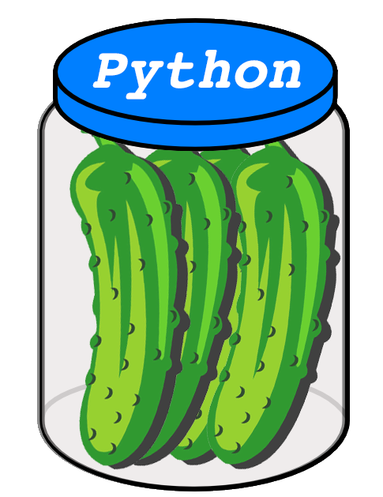
Pickle module in Python
In Python, the pickle module lets you serialize and deserialize data.
Essentially, this means that you can convert a Python object into a stream of bytes and then reconstruct it (including the object’s internal structure) later in a different process or environment by loading that stream of bytes.n-pickle/

Slide 5
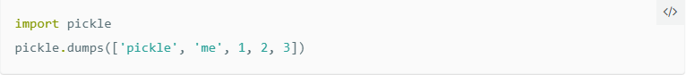
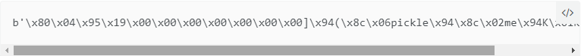
How to dump and load?
In Python you can serialize objects by using pickle.dumps():
The pickled representation we’re getting back from dumps will look like this:

Slide 6
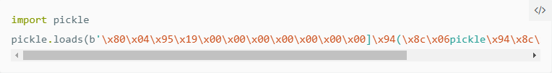
How to dump and load?
And now reading the serialized data back in…
…will give us our list object back:

Slide 7

How to dump and load?
The pickle module is not secure

Slide 8
__reduce__
The __reduce__ method
Reading a bit further down in the docs we can see that implementing __reduce__ is exactly what we would need to get code execution, when viewed from an attacker’s perspective

Slide 9
__reduce__
The __reduce__ method
So by implementing __reduce__ in a class which instances we are going to pickle, we can give the pickling process a callable plus some arguments to run. While intended for reconstructing objects, we can abuse this for getting our own reverse shell code executed.

Slide 10
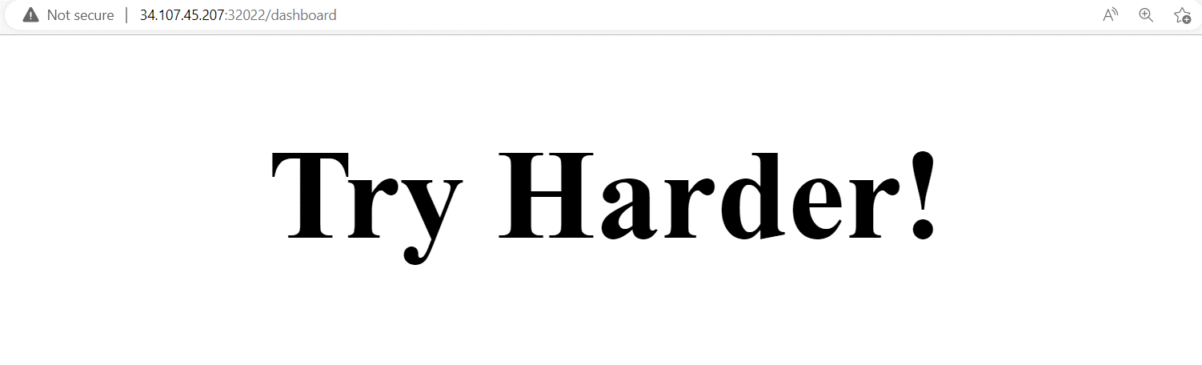
Laboratory: sweet-and-sour
Description:
The jar has been opened, figure out what is sweet and what is sour and get the flag.
Flag format: CTF{sha256}
Level: Medium
Server: 34.107.45.207:32022
Hints:
Hint 1: Try to find yourself ^^
Once we open the machine, the “Try Harder!” message is displayed

Slide 11
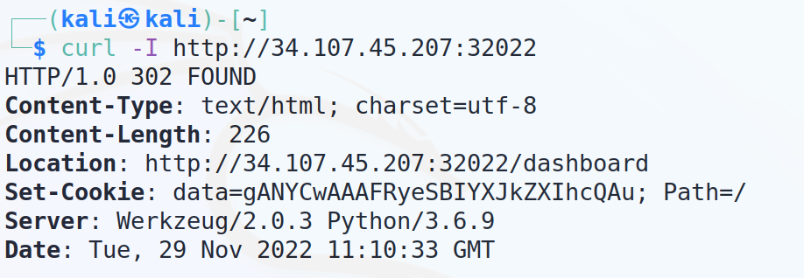
Laboratory: sweet-and-sour
Usually, when something similar is noticed, it is recommended to look in the header section of the web application.
From header we can obtain, that it is python server and set-cookie is shown right there

Slide 12
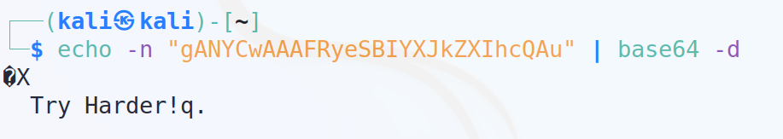
Laboratory: sweet-and-sour
Once we try to decode the cookie using base64, we can see, that some words appeared as the result

Slide 13

Laboratory: sweet-and-sour
After decoding the cookie, we obtain the message "Try harder" and some junk data. Based on what information we have gathered until now ( Python server, cookies in base64 format + some junk ) we can conclude that this is a pickle server.

Slide 14
Laboratory: sweet-and-sour
At this moment we can send some pickle payloads to the server which will lead to arbitrary file read vulnerability.
Serialization and deserialization - the process of converting a Python object into a byte stream in order to store it in a file/database, maintain program state across sessions, or transport data across a network.
Unpickling the pickled byte stream allows you to recreate the original object hierarchy

Slide 15
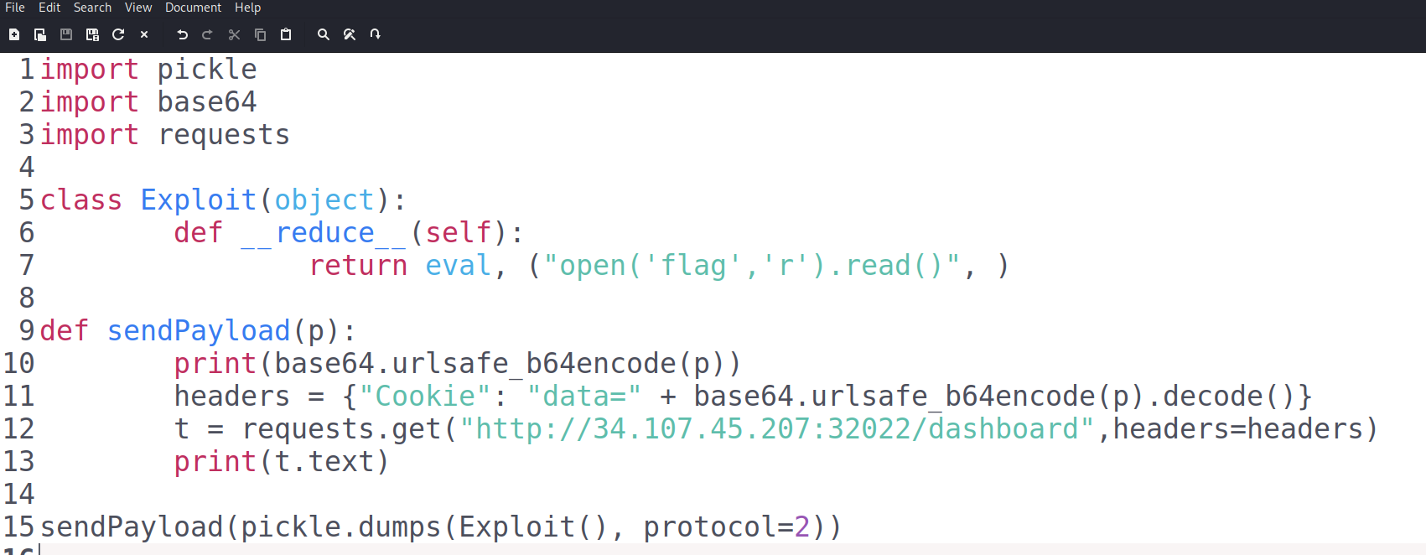
Laboratory: sweet-and-sour
Payload
Notes:
CTF{ccc1ccef217ed19c492bdada049ad2b0fbf1adcb72a92f13ab153aae068f797f}

Slide 16
Laboratory: sweet-and-sour
As we have an already prepared exploit, all we need to do is to add the IP and port of the machine in the script
Here we got the flag:

